Slide 1
ProductBuzz Analysis
The goal of this project is to develop a system that can analyze tweets related to an upcoming product in order to gain insights about consumer sentiment and public perception. This information can be used by the company to make informed decisions about the marketing and promotion of the product

Slide 2
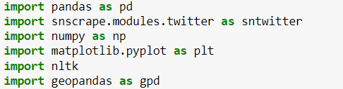
Required Packages
Import these necessary python packages
Download all these packages
Use pip install
The snscrape.modules.twitter module is used to
scarpe the data from twitter
The geopandas is used to plot data in map
Nltk contains the functions required for nlp

Slide 3

Nltk packages
Download all these natural language toolkits:
stopwords
punkt
wordnet
omw-1.4
Run these commands once to avoid repeated
downloads

Slide 4

Import the different functions from nltk for natural language processing
stopwords - word that is automatically omitted from a computer-generated. Examples of stop words in English are “a”, “the”, “is”, “are”.
word_tokenize - word_tokenize is a function in Python that splits a given sentence into words using the NLTK library.
WordNetLemmatizer - Wordnet is an large, freely and publicly available lexical database for the English language aiming to establish structured semantic relationships between words.
PorterStemmer - The Porter stemming algorithm is a process for removing the commoner morphological and inflexional endings from words in English.

Slide 5
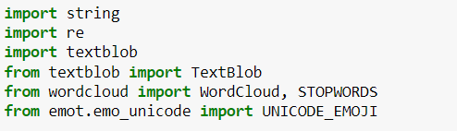
Import regular expression to work with the natural language processing
Import STOPWORDS from wordcloud to remove the stopwords from the text
Import textblob to check the polarity of a given text to analyse the sentiment
Import UNICODE_EMOJI to remove the emojis from the text

Slide 6
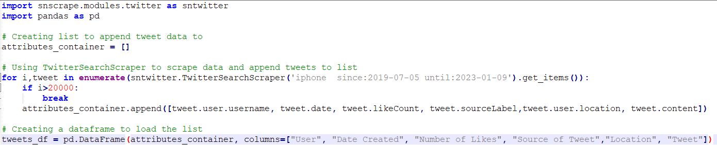
Twitter Scrapping
Create a list container to hold the values of each tweet
Inside the TwitterSearchScrapper give the query to be satisfied
Optionally we can mention the time window to scarp data
Inside the if-else mention the amount of iterations the scrapping has to perform
This is also optional and can be done to derive whatever amount of data
Append the attributes to the list already created
Using the list data create a dataframe

Slide 7
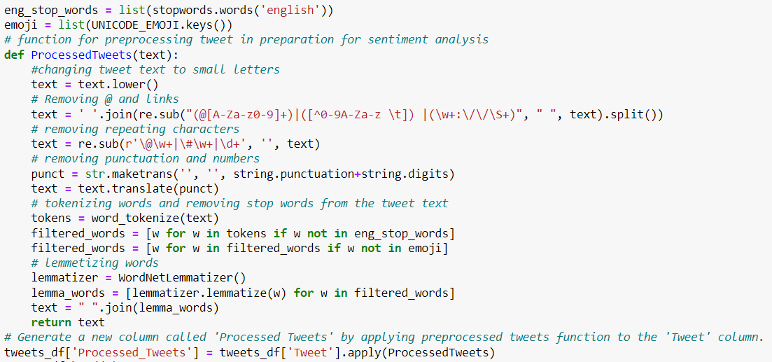
Text Processing
Import all English stopwords and emojis and store them in a list
Define a function ProcessedTweets which runs the text processing on tweets
Convert all the texts to lower case
Remove unwanted tags and links
Remove all the punctuations and digits using maketrans and translate function in python
Tokenize the text and store only if the text is not a stopword or emoji
Lemmatize the text to reduce inflection of words

Slide 8
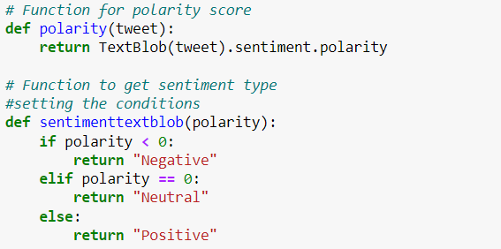

Sentiment Analysis
Identify the polarity of the tweet using textblob which gives out values from the range [-1,1] based on how much positive words are there in the text
Polarity=0 - The tweet is neutral
Polarity=-1 - The tweet gives negative sentiment
Polarity=1 - The tweet gives a positive sentiment
Store the values of polarity and the sentiment as columns in the dataframe

Slide 9
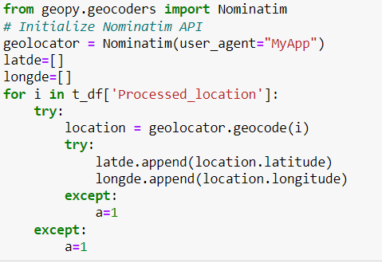
Tweets Worldmap
Apply text processing to the Location column and store it
Import Nominatim from geopy.geocoders
Mention the app name that you are using for your reference data
Create a list to store longitude data and latitude data
Get the geocode location and store it in location using geolocator.geocode.
Note:
Use try except blocks so that the rows without proper location data will be ignored

Slide 10
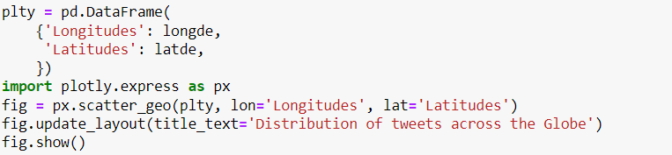
Store the values of longitude and latitude in a dataframe
Import ploty.express to create a interactive map
Use the scatter_geo function to plot the points as a scattered data
Mention the dataframe to compute and the columns of latitude and longitude as the parameters of the function
Add Title to the map using update_layout

Slide 11

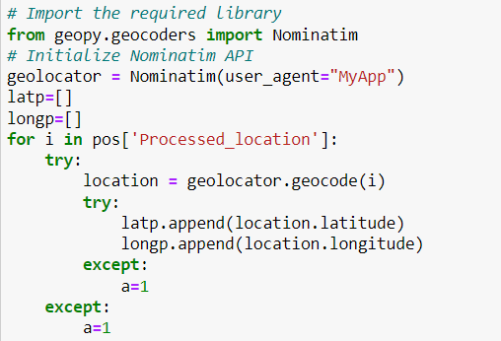
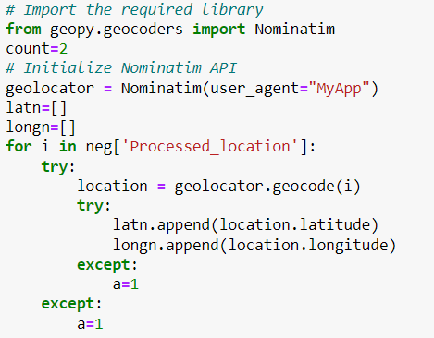
Positive Negative Worldgraph
Split the dataset based on the polarity to produce dataframe with only positive tweets and only negative tweets
Repeat the same process of getting longitude and latitude using nominatim

Slide 12
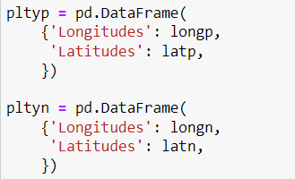
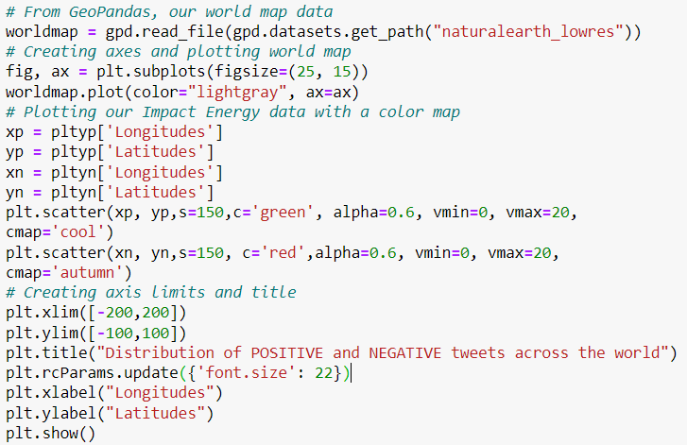
Store the values of longitudes and latitudes in a dataframe
Use read_file from geopandas to read the worldmap dataset
Plot the world map
Store the positive sentiment coordinates and negative sentiment coordinates in different variables
Use scatter plot to plot the dataset of the coordinates in the worldmap

Slide 13

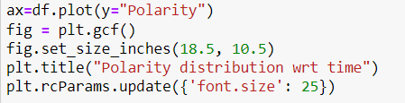

Polarity Distribution
Plot a histogram on polarity column to visualize the distribution of the
Plot the line graph
Note:
This graph is plotted in python further visualization tools would give a graph with wider time window
Plot a histogram on polarity column to visualize the distribution of the

Slide 14

Comparison Piechart
One of the scrapping attributes allow us to check from which device that tweet was posted
This information can be used in this model to check how many people from different platforms are interested to switch to iPhone
Save the data of user platform in a dataframe
Store the sentiment counts of each unique value(Neutral, Positive, Negative)

Slide 15
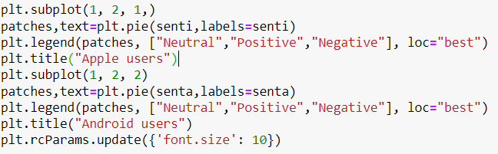

Plot different sentiment counts in the pie chart
Add title and legend using different functions of matplotlib.pyplot
Also print the percentage of users who are interested in switching their platforms

